Slide 1
Big Data Analytics in
Energy & Utilities
Capstone Project –DP1812
Customer and Product Profiling
Nikita Dange, Sanjiv Sharan, Shriti Datta
11 July, 2020

Slide 2
Agenda
Overview
Architecture and Workflow
Data Exploration & Processing
Model Implementation and Results
Analysis of Results & Optimization
Deliverables
Next Steps
Appendix

Slide 3
Overview
Objective
Perform Customer Analytics on e-commerce data to create solutions which help organization to increase sales by spending less money. Classifying customers into segments. Anticipate the purchases that will be made by a new customer.
Data Source
Online Retail-ecommerce (UK Retailers) One Year data UCI Machine Learning Repository
Technology and Software
Programming Language: Python Version Control: Git
Learnings
Understood different classification techniques Understood text analytics Learned different plotting diagrams
Output
Customer Clustering Product Clustering

Slide 4
Architecture and Workflow
Data Extraction
Data Source
Data Exploration Analysis
Data Cleaning and Exploration
Data Wrangling
Model Creation
Data Visualization
Model Validation
Optimization
Classification Models
Model Implementation
Clustering
Deployment
Architecture
Workflow

Slide 5
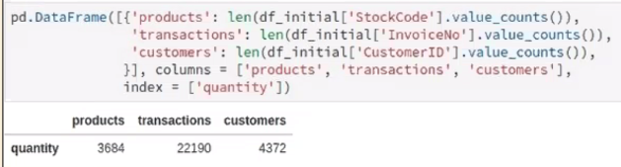
Data Exploration & Processing
8 features present in the dataset. i.e. Invoice No., Stock Code, Description, Quantity, InvoiceDate, UnitPrice, CustomerID, Country.
Analyze significance of all data features and remove unwanted features
Sanity check of the important data (missing values, NA, duplicates, Purchase records)
Assessment of frequency distribution of data and removal of extremes (especially extremely large reviews)
Country
Customer and Products
Product Categories
Defining product categories
Identifying data for creating a prototype model (relatively uniform distribution across reviews preferred)
Analysis of cancelled orders and reorders.
Bulk orders

Slide 6
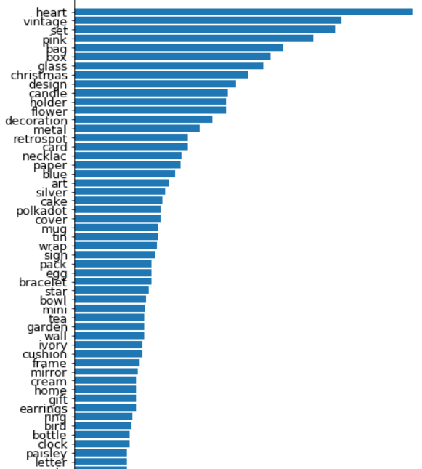
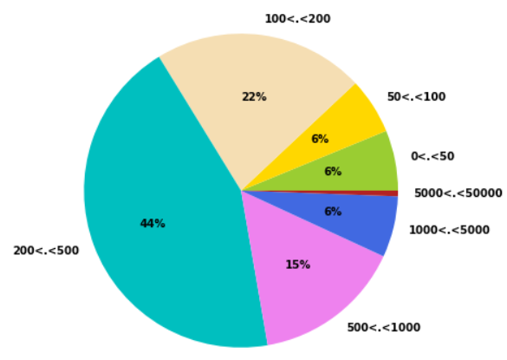
Data Exploration Charts
Distribution of order amounts
Distribution of product keywords
More than 1400 keywords from 3684 products identified and the most frequent ones appear in more than 200 products
Words appearing more than 13 times have been considered
Majority of orders concern relatively large purchases given that ∼65% of purchases give prizes in excess of £ 200.

Slide 7
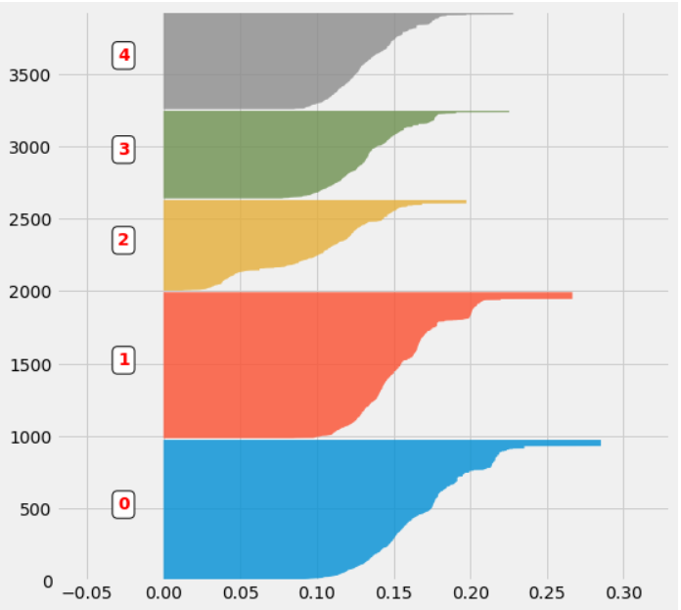
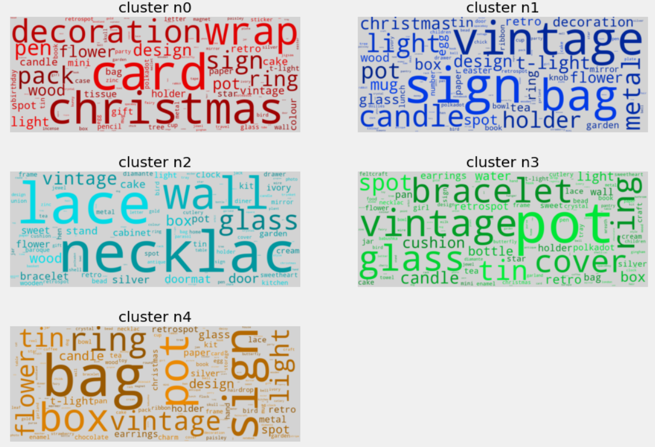
Data Exploration Charts
Product Cluster Analysis
Word Cloud
K-means clustering
Silhouette scores of each element of the different clusters
Word cloud based keywords from 5 clusters

Slide 8
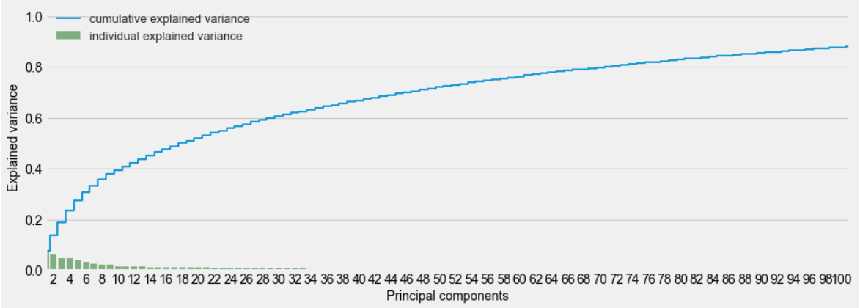
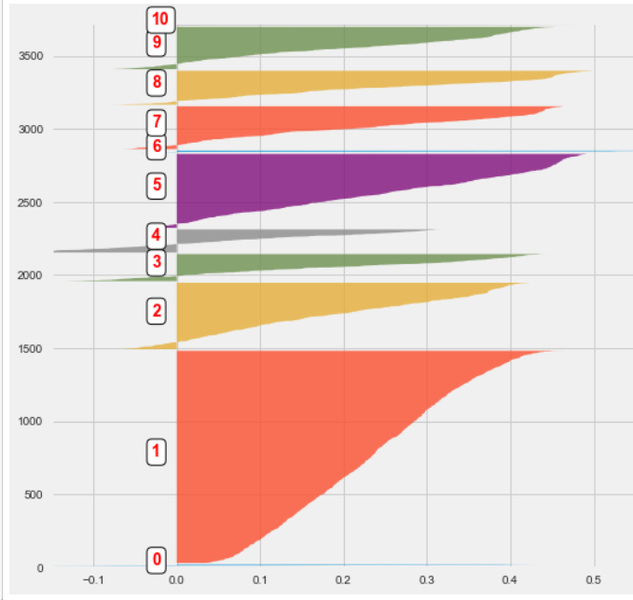
Data Exploration Charts
Customer categories
Formatting data
Grouping products
Splitting of the dataset
Grouping orders
Creating customer categories
Data encoding
Creating categories
Performed PCA to ensure that the clusters are truly distinct.
100 components are required to explain 90% of the variance of the data.
Different clusters are indeed disjoint

Slide 9
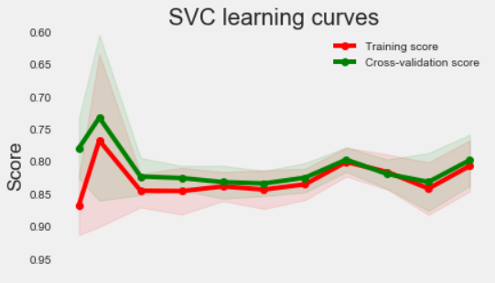
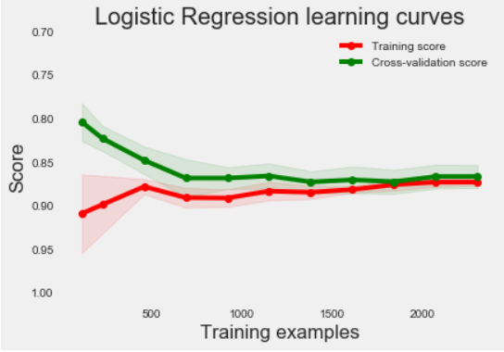
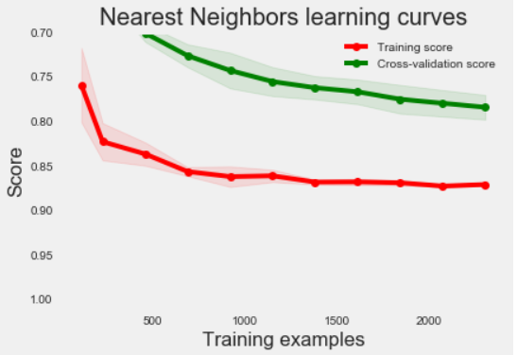
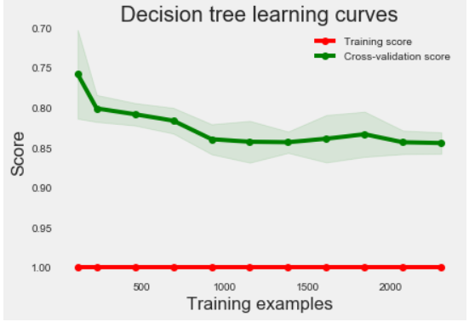
Model Creation Classification of customers

Slide 10
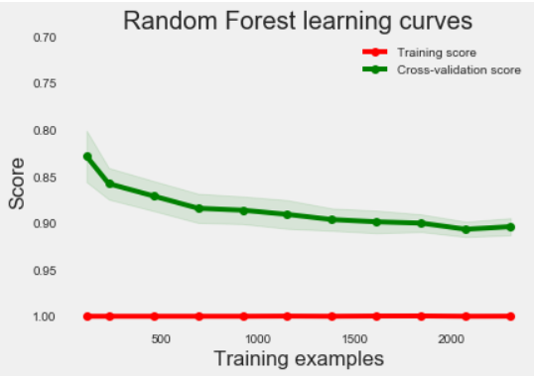
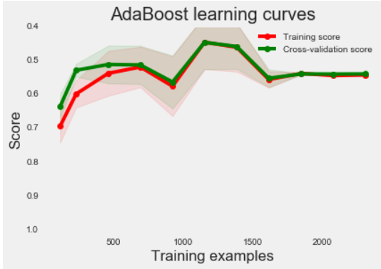
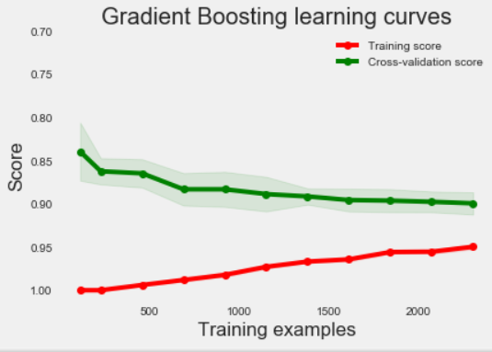
Model Creation Classification of customers
Results of different classifiers can be combined to improve the classification model. This can be achieved by selecting the customer category as the one indicated by the majority of classifiers.
VotingClassifier method of the sklearn package was used.

Slide 11
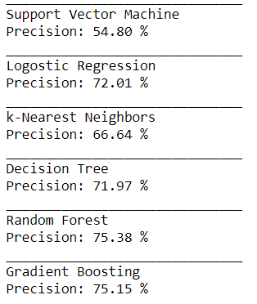
Model Analysis
Quality of the classifier can be improved by combining different classifiers and their respective predictions.
We chose Random Forest, Gradient Boosting and k-Nearest Neighbors predictions to improve predictions.
Precision: 75.70 %

Slide 12
Further Optimization Areas
With regards to Machine Learning model
Optimization in keyword generation
Use other classification techniques
Exploring other hyper-parameter tuning
With regards to overall functioning and performance
Improve execution time and performance
Comparison of results across R and Python
Apply Deep Learning techniques for better results
More visualization tool to be explored to better user friendly interface

Slide 13
Conclusion
Combining multiple classifiers give better accuracy and prediction.
Number of clusters created for product and customers plays an important role in achieving higher performance.

Slide 14
Thank You

